Slide 1

Urban v. Rural by Paul, Souzane, & Chidi

Slide 2
Agenda
Project Introduction/Hypothesis
Data Sources
The Process (Part I) – Exploration & Cleanup
The Process (Part II) – Analysis
Final Results/Conclusions
Questions

Slide 3
Introduction/Hypothesis

Slide 4
The purpose of this project is to compare an analyze the quality of living between urban and rural America.
Based on the variables tested, we will provide our determination of which provides the best quality of life.
Many believe that life is better lived in the city; we are confident that data will determine the truth.
Our hypothesis:

Slide 5
Data Sources

Slide 6
Source 1 – Census: Demographic data was sourced from the American Community Survey (2016
Source 2 – Google Maps API: Paired with Census data, gmaps was utilized to create maps to display comparisons
Source 3 – 2010 Census: Data used to determine urban and rural zip codes based on percentage

Slide 7
The Process (Part I) – Exploration & Cleanup

Slide 8
Data Sets
Demographic data was pulled from the American Community Survey (2016) at Census Block Group level (not the Census API).
After formatting Census block group boundaries to JSON files and identifying Census attribute tables, it was determined that ‘Zip Codes’ would be more effective.
Census API wrapper allows for a command for all zip codes for the 2016 American Community Survey.
This made use of the Census API whereas with the Census Block Group, 25 different csv files were required.

Slide 9
Data Sets (cont.)
Using zip codes provided benefits:
Make use of the census API
More data per zip than census block group
Ability to view counties and their rural and urban percentages
Using census block group provided obstacles:
Other data sets that utilized census block group is limited
Highly specific geographic area
Over 200,000 locations
Enough sufficient data is difficult to generate

Slide 10
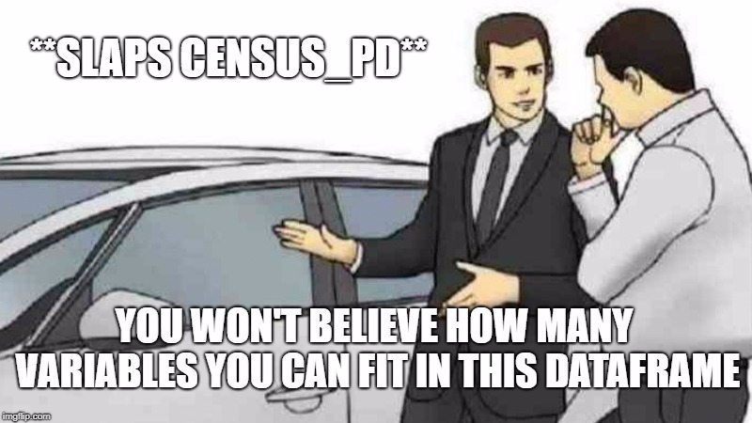

Slide 11
Census API Dataframe

Slide 12
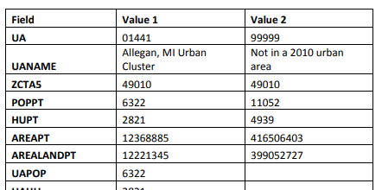
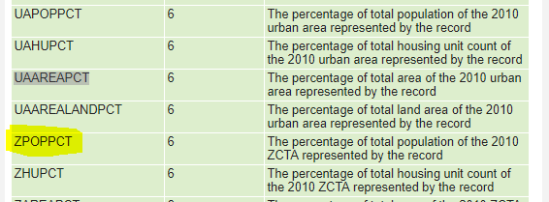
2010 Urban Area to ZIP Code Tabulation Area (ZCTA) Relationship File
Zip codes could have
1 value where 100% urban (just UA)
1 value where 100% rural (just 99999)
2 values where UA and 99999
Or 2 UAs (13 of those)
3-5 values where multiple UAs and maybe an 99999
Filter and countif
46,295 rows
33,140 unique zip codes

Slide 13
The Process (Part II) - Analysis

Slide 14
Final Results/Conclusion

Slide 15


